Slide 1




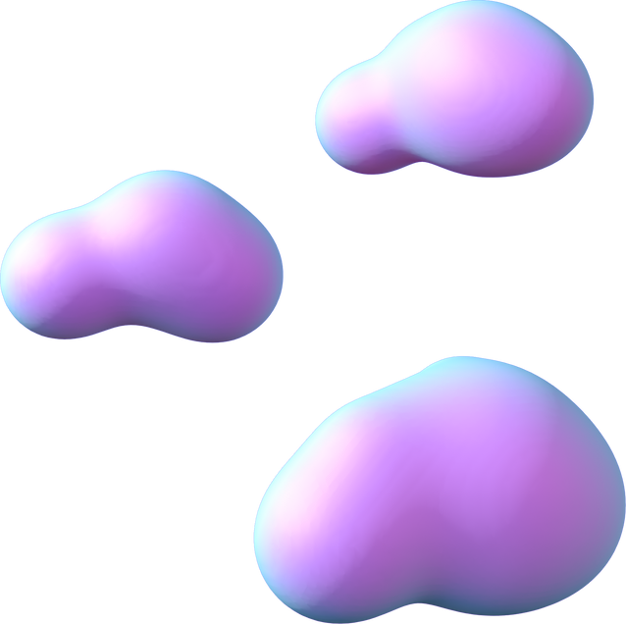
VIRTUAL MACHINE SCALE SET
FOR DEPLOYING A HIGH AVAILABLE WEBSITE
Page 01

Slide 2
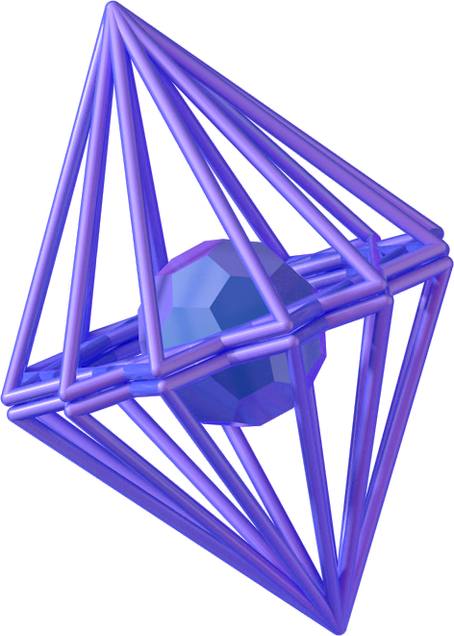
TEAM MEMBERS:
G.V.Uday Kumar
K.Sai Dixith
A. Pavani Rasagna
G.Indrani
Guided By:
Mr.Hari(magic bus trainer)
Page 02

Slide 3

PROJECT OVERVIEW
Create a Virtual Machine Scale Set (VMSS): Set up a VMSS in Azure to manage multiple identical virtual machines.
Configure Autoscaling: Enable autoscaling rules to adjust the number of VMs based on traffic or workload.
Add a Load Balancer: Attach an Azure Load Balancer to distribute traffic evenly and monitor instance health.
Ensure Redundancy: Deploy VMs across multiple availability zones for fault tolerance and high availability.
Deploy the Website: Install your web server and application, secure the environment, and set up DNS for your domain.
Page 03

Slide 4
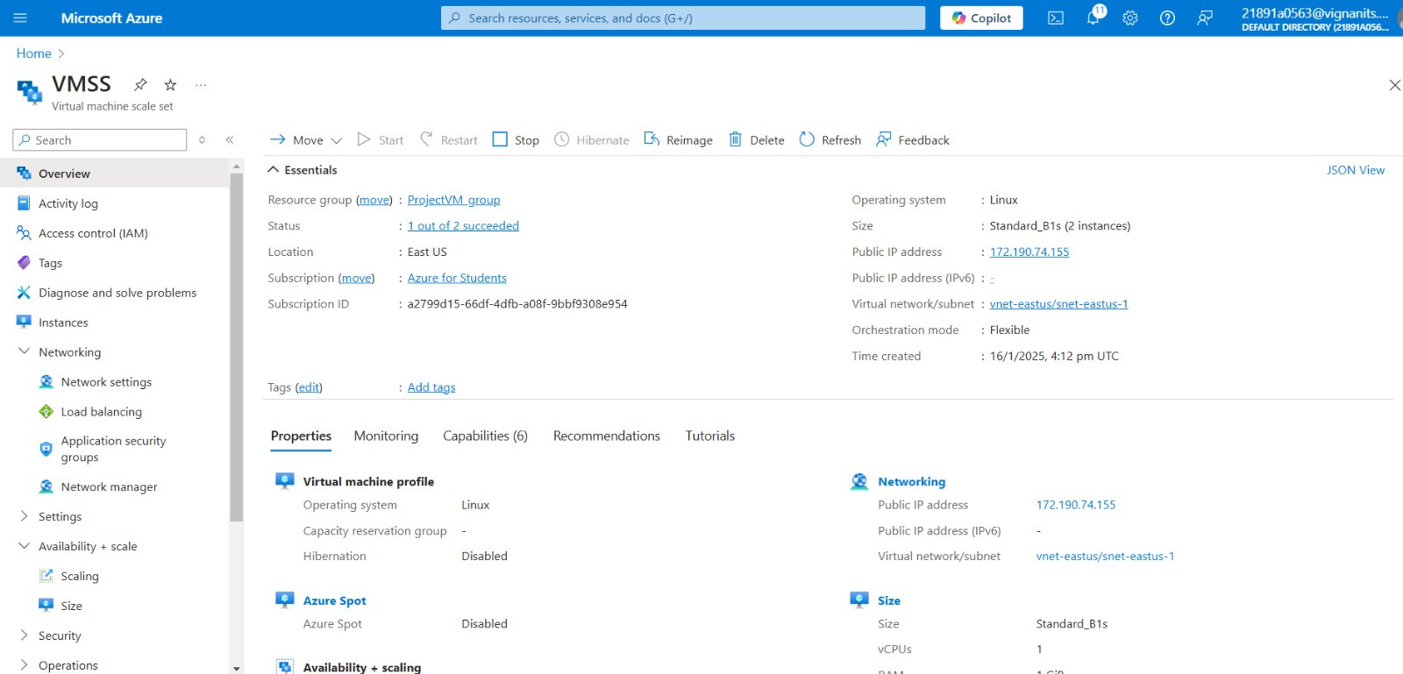

IMPLEMENTATION:
Step -1: creating VMSS
Page 04

Slide 5
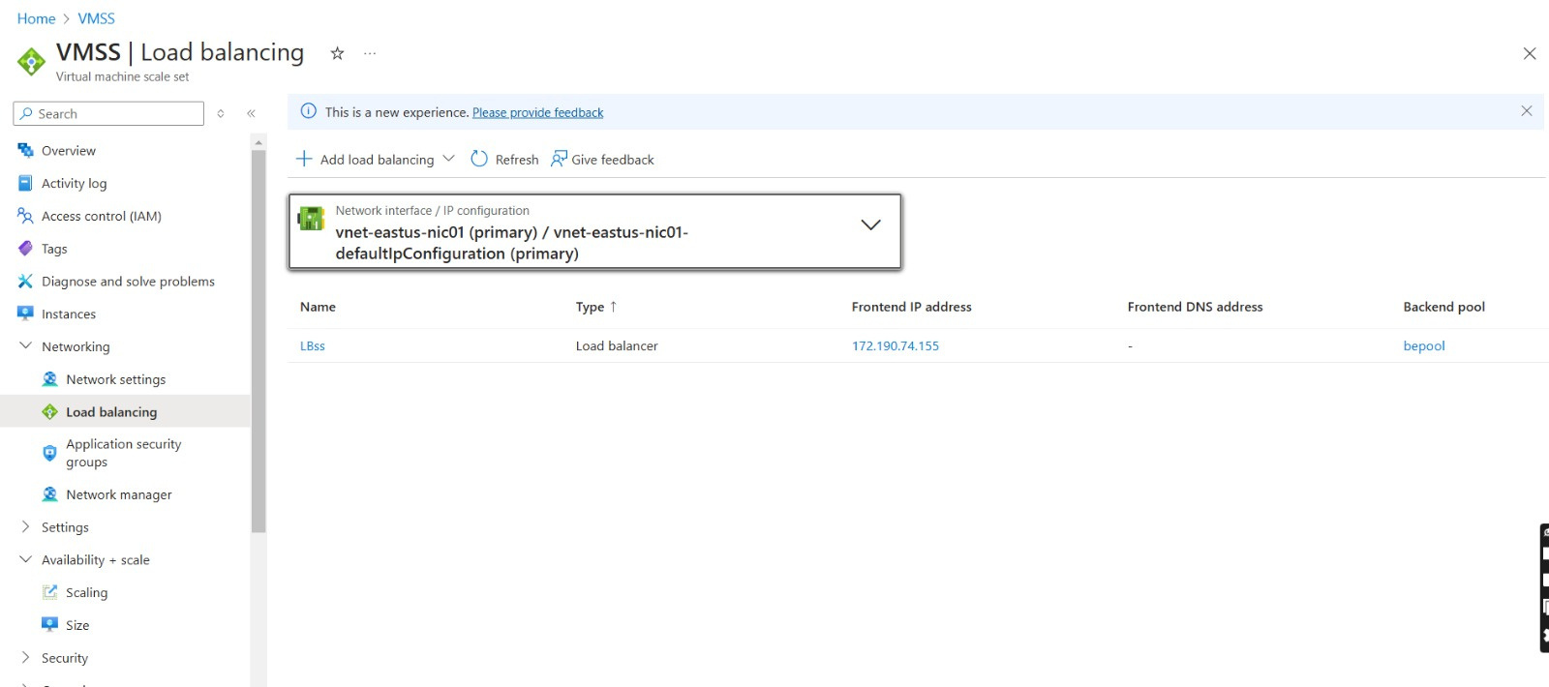
Step2: Applying Load Balancing
Page 05

Slide 6
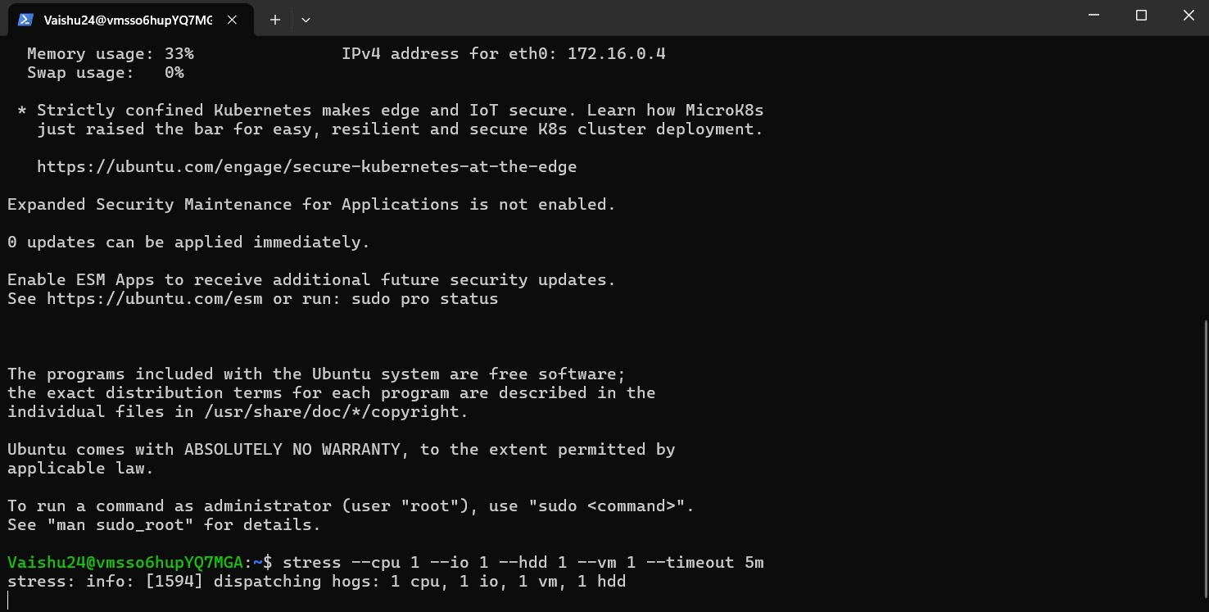
Step3: Applying Stress in Power shell
Page 06

Slide 7
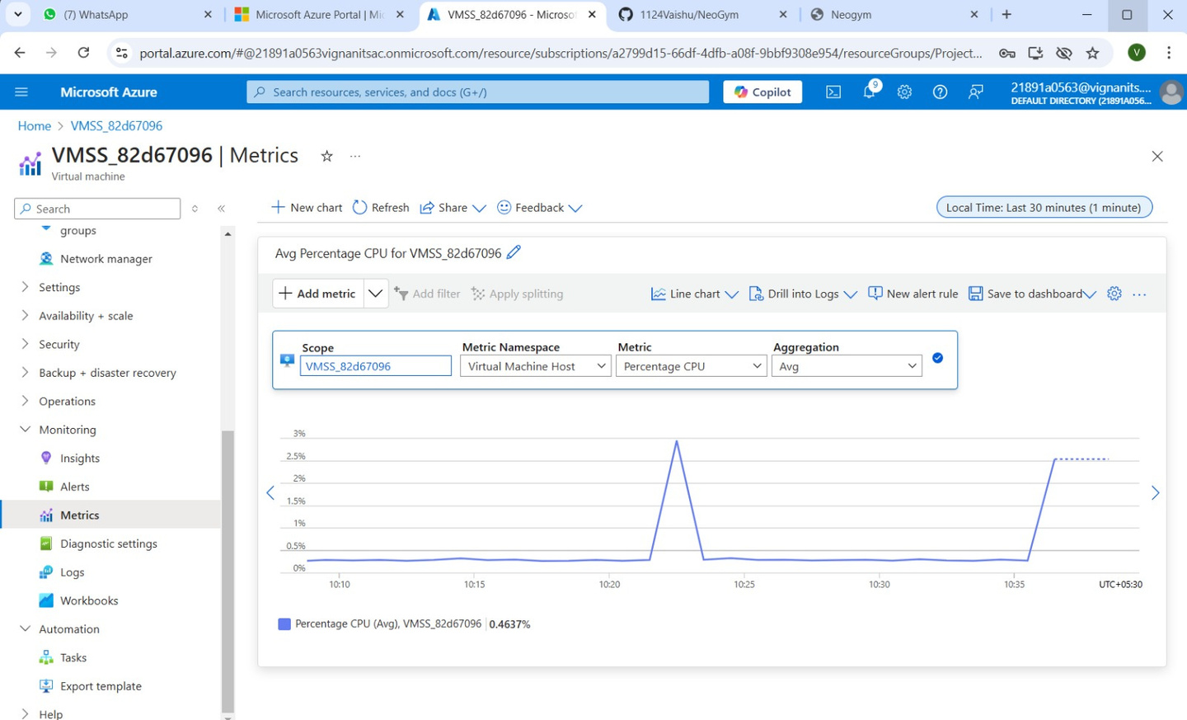
Step4: After applying the stress the initial metrics
Page 07

Slide 8
Step5: After the timeout the stress metrics
Page 08

Slide 9
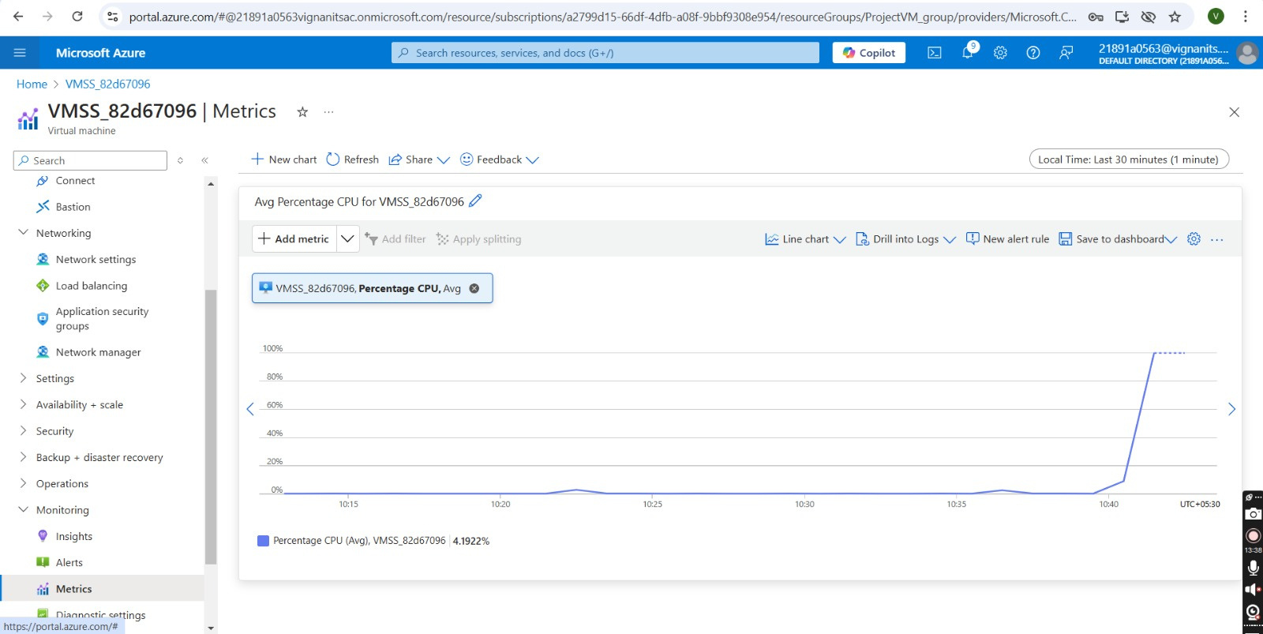
Step5: After the timeout the stress metrics
Page 09

Slide 10
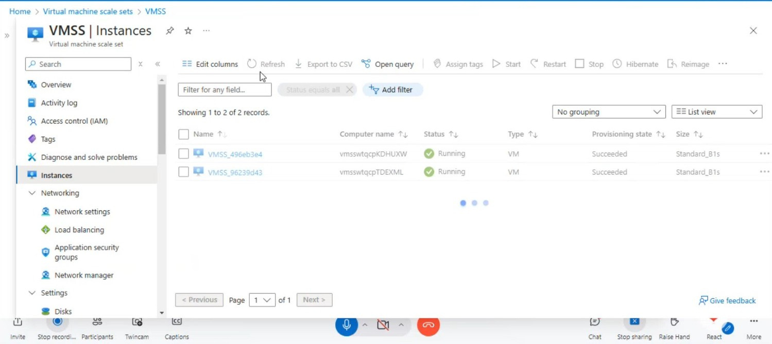
Step6: The Virtual Machine is Deployed
Page10

Slide 11
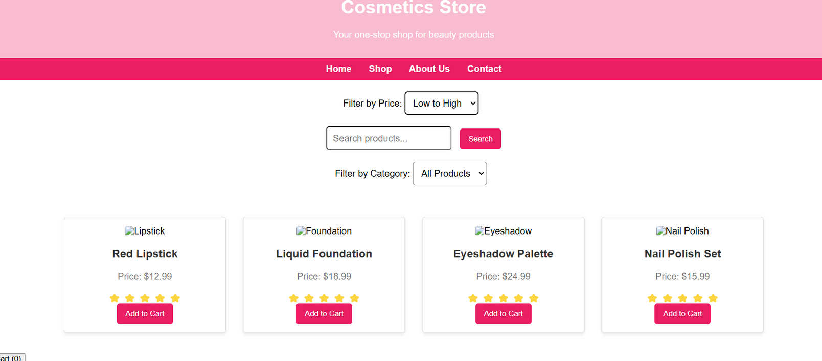
Step7: The Web site
Page 11

Slide 12
Step8: The Virtual Machine is Deployed according to the stress
Page 12

Slide 13
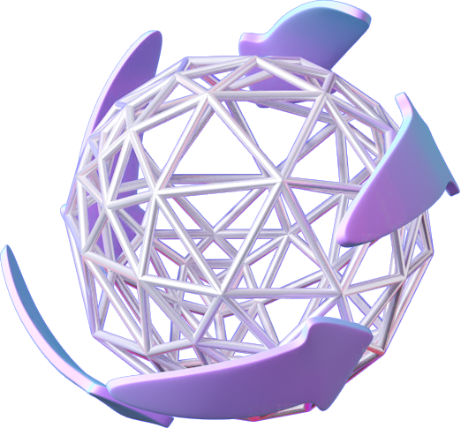
DEMONSTRATION OF THE PROJECT:
#!/bin/bash
# Update and upgrade the system
sudo apt update -y && sudo apt upgrade -y
# Install Nginx
sudo apt install nginx -y
# Enable Nginx to start on boot
sudo systemctl enable nginx
# Start Nginx service
sudo systemctl start nginx
# Install stress (for testing purposes)
sudo apt install stress -y
# Navigate to the /tmp directory
cd /tmp
# Clone the repository from GitHub
git clone https://github.com/harisaideepu-cloud/test1.git test1
# Copy the contents to the Nginx web directory
sudo cp -r /tmp/test1/* /var/www/html/
# Change ownership to www-data user and group (for Nginx)
sudo chown -R www-data:www-data /var/www/html/
# Set proper permissions for the web directory
sudo chmod -R 755 /var/www/html/
# Restart Nginx to apply changes
sudo systemctl restart nginx
Page 13

Slide 14


CONCLUSION:
Virtual Machine Scale Sets (VMSS) automatically scale virtual machines based on traffic.
Deploying VMs across availability zones ensures fault tolerance and high reliability.
A load balancer evenly distributes traffic and monitors the health of VM instances.
Autoscaling optimizes resource usage, reducing operational costs during low demand.
Centralized management simplifies updates and maintenance across all VMs.
Ensures a scalable and resilient infrastructure for hosting websites or applications.
Supports high performance, even during traffic spikes.fficiently handles dynamic workloads with minimal manual intervention.
Page 14

Slide 15
THANK YOU

